Slide 1
W3C WoT in a nutshell
Yongjing Zhang (zhangyongjing@Huawei.com)
W3C WoT IG Co-chair
24 May 2017, oneM2M Industry Day @ TP#29

Slide 2
Web of Things (WoT) overview
WoT Thing Description (TD)
WoT Scripting API
WoT work organization & collaboration
oneM2M-WoT Interworking

Slide 3





W3C WoT Mission
Interconnect the silos ＝ de-silo
Web of Things
…
“enable easy integration across IoT platforms and application domains” “complementing available standards”

Slide 4
The Role of W3C in IoT/WoT – Play to the Strengths
Application | Define thing behaviour in terms of their properties, actions and events, using APIs for control of sensor and actuator hardware
Things | Software objects representing abstract or physical devices and state Abstract thing to thing interaction Semantics and Metadata, Data models and Data
Transfer | Bindings of abstract messages to mechanisms provided by each protocol, including choice of communication pattern, e.g. pull, push, pub-sub, peer to peer, etc.
Transport | REST based protocols, e.g. HTTP, CoAP Pub-Sub protocols, e.g. MQTT, XMPP Others, including non IP transports, e.g. Bluetooth
Network | Underlying communication technology with support for exchange of simple messages (packets) Many technologies designed for different requirements
Application Developer
(WoT focus)
Platform Developer
(IoT focus)
Notes:
This is where W3C is good at and has a lot of treasures of legacy, e.g. semantics, web APIs…

Slide 5

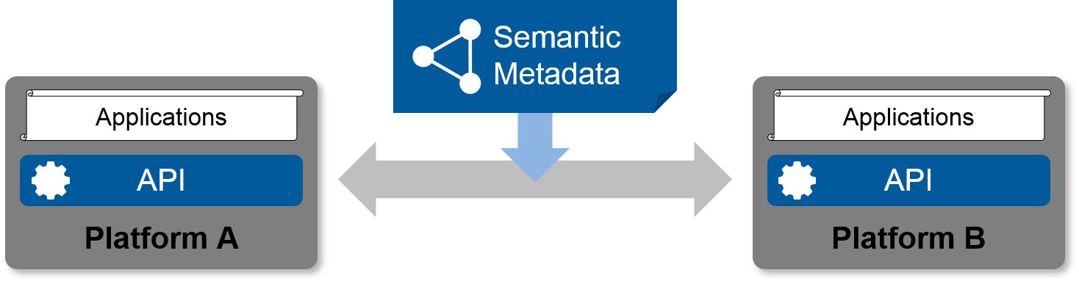
Semantic Metadata is the Key
Metadata enables interoperability
Describe the interfaces exposed to applications
Describe the communication and security requirements for accessing things
Describe the data models, semantics, and domain constraints
Metadata simplifies application development
Decouples underlying protocols
Enables automated tooling
Notes:
Work at the meta data level, decoupled from specific implementations, simple but powerful descriptive capabilities to enable cross-platform interoperability.

Slide 6
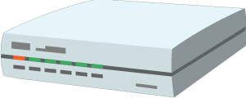


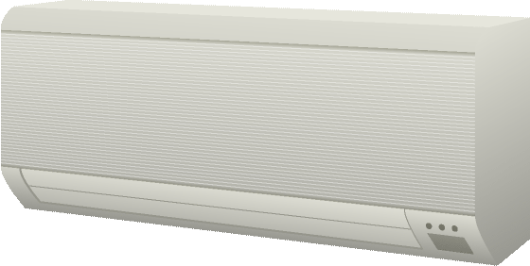
W3C WoT Framework
Cloud Mirrors
Local Hubs
Application
Remote access
Application
Device Shadow
Virtual Thing
Standardized APIs for portable application logic
(Scripting API)
Semantic metadata
(Thing Description)
Scripting API
Scripting API
Interaction Model
Interaction Model
Binding Templates
Binding Templates
Web integration
Direct Thing-to-Thing
Complementing
existing devices
and platforms
Application
Existing Device
Application
Web Browser
+
Thing
Scripting API
Scripting API
Interaction Model
(Thing Description, Binding Templates)
⇒
Interaction Model
Binding Templates
Thing
Binding Templates
Powerful or constrained Things

Slide 7
4 Key Components: W3C WoT Building Blocks
WoT Scripting API:
A standardized API to simplify IoT application development and enable portable scripts across vendors and device, gateway, and cloud platforms.
WoT Servient
Runtime Environment
WoT Thing Description (TD):
Provides metadata of the interactions, data model, communication, as well as security mechanisms of the Thing
App Script
Scripting API
TD
WoT Binding Templates:
The TD also describes the usage of protocols. A vanilla protocol stack can be configured at runtime to produce message that will be understood by the targeted.
Interaction Model
Binding Templates
Security & Privacy:
W3C WoT does not invent new mechanisms, but ensures that all building blocks provide means to describe the security and privacy mechanisms used in a specific platform and provides adversary testing of Things.
Server
Client

Slide 8
WoT Thing Description
Describe Thing, communication, and security metadata
https://w3c.github.io/wot-thing-description/

Slide 9
TD Example
JSON-LD (Linked Data)
W3C WoT TD vocabulary
{
"@context": [
"http://w3c.github.io/wot/w3c-wot-td-context.jsonld",
{ "domain": "http://example.org/actuator#" }
],
"@type": "Thing",
"name": "MyLEDThing",
"base": "coap://myled.example.com:5683/",
"security": {
"cat": "token:jwt",
"alg": "HS256",
"as": "https://authority-issuing.example.org"
},
"interactions": [
{
"@type": ["Property", "domain:onOffStatus"],
"name": "status",
"outputData": {"valueType": {"type": "boolean"}},
"writable": true,
"links": [
{
"href": "pwr",
"mediaType": "application/exi"
},
{
"href": "http://mytemp.example.com:8080/status",
"mediaType": "application/json"
}
]
},
{
"@type": ["Action", "domain:fadeIn"],
"name": "fadeIn",
"inputData": {
"valueType": {"type": "integer"},
"domain:unit": "domain:ms"
},
"links": [
{
"href": "in",
"mediaType": "application/exi"
},
{
"href": "http://mytemp.example.com:8080/in",
"mediaType": "application/json"
}
]
},
{
"@type": ["Action", "domain:fadeOut"],
"name": "fadeOut",
"inputData": {
"valueType": {"type": "integer"},
"domain:unit": "domain:ms"
},
"links": [
{
"href": "out",
"mediaType": "application/exi"
},
{
"href": "http://mytemp.example.com:8080/out",
"mediaType": "application/json"
}
]
},
{
"@type": ["Event", "domain:alert"],
"name": "criticalCondition",
"outputData": {"valueType": {"type": "string"}},
"links": [
{
"href": "ev",
"mediaType": "application/exi"
}
]
}
]
}
domain-specific vocabulary
JSON Schema

Slide 10
{
"@context": [
"http://w3c.github.io/wot/w3c-wot-td-context.jsonld",
{ "domain": "http://example.org/actuator#" }
],
"@type": "Thing",
"name": "MyLEDThing",
"base": "coap://myled.example.com:5683/",
"security": {
"cat": "token:jwt",
"alg": "HS256",
"as": "https://authority-issuing.example.org"
},
"interactions": [
{
"@type": ["Property", "domain:onOffStatus"],
"name": "status",
"outputData": {"valueType": {"type": "boolean"}},
"writable": true,
"links": [
{
"href": "pwr",
"mediaType": "application/exi"
},
{
"href": "http://mytemp.example.com:8080/status",
"mediaType": "application/json"
}
]
},
{
"@type": ["Action", "domain:fadeIn"],
"name": "fadeIn",
"inputData": {
"valueType": {"type": "integer"},
"domain:unit": "domain:ms"
},
"links": [
{
"href": "in",
"mediaType": "application/exi"
},
{
"href": "http://mytemp.example.com:8080/in",
"mediaType": "application/json"
}
]
},
{
"@type": ["Action", "domain:fadeOut"],
"name": "fadeOut",
"inputData": {
"valueType": {"type": "integer"},
"domain:unit": "domain:ms"
},
"links": [
{
"href": "out",
"mediaType": "application/exi"
},
{
"href": "http://mytemp.example.com:8080/out",
"mediaType": "application/json"
}
]
},
{
"@type": ["Event", "domain:alert"],
"name": "criticalCondition",
"outputData": {"valueType": {"type": "string"}},
"links": [
{
"href": "ev",
"mediaType": "application/exi"
}
]
}
]
}
Property
Action

Slide 11
{
"@context": [
"http://w3c.github.io/wot/w3c-wot-td-context.jsonld",
{ "domain": "http://example.org/actuator#" }
],
"@type": "Thing",
"name": "MyLEDThing",
"base": "coap://myled.example.com:5683/",
"security": {
"cat": "token:jwt",
"alg": "HS256",
"as": "https://authority-issuing.example.org"
},
"interactions": [
{
"@type": ["Property", "domain:onOffStatus"],
"name": "status",
"outputData": {"valueType": {"type": "boolean"}},
"writable": true,
"links": [
{
"href": "pwr",
"mediaType": "application/exi"
},
{
"href": "http://mytemp.example.com:8080/status",
"mediaType": "application/json"
}
]
},
{
"@type": ["Action", "domain:fadeIn"],
"name": "fadeIn",
"inputData": {
"valueType": {"type": "integer"},
"domain:unit": "domain:ms"
},
"links": [
{
"href": "in",
"mediaType": "application/exi"
},
{
"href": "http://mytemp.example.com:8080/in",
"mediaType": "application/json"
}
]
},
{
"@type": ["Action", "domain:fadeOut"],
"name": "fadeOut",
"inputData": {
"valueType": {"type": "integer"},
"domain:unit": "domain:ms"
},
"links": [
{
"href": "out",
"mediaType": "application/exi"
},
{
"href": "http://mytemp.example.com:8080/out",
"mediaType": "application/json"
}
]
},
{
"@type": ["Event", "domain:alert"],
"name": "criticalCondition",
"outputData": {"valueType": {"type": "string"}},
"links": [
{
"href": "ev",
"mediaType": "application/exi"
}
]
}
]
}
Event (under construction, sources, sinks, …)

Slide 12
WoT Thing Description
JSON-LD is just one possible representation
Good for discussion, accepted by Web people
TD is a semantic model
Backed by RDF and Linked Data vocabularies
Yet complexity of Semantic Web can be ignored
Other formats possible
EXI, CBOR, … for machines
Custom application/wot-td+json for developers
Just serializations of the semantic model

Slide 13
WoT Scripting API
Program and deploy IoT applications like Web applications
https://w3c.github.io/wot-scripting-api/

Slide 14
Script Example (Expose Thing)
// create software object to represent local Thing
WoT.newThing("counter")
.then( (thing) => {
thing
// programmatically add interactions (builder pattern)
.addProperty("count", {"type": "integer"}) // JSON Schema
.addAction("increment")
.onInvokeAction("increment", () => {
console.log("incrementing counter");
// persistent state is managed by runtime environment
let value = thing.getProperty("count") + 1;
thing.setProperty("count", value);
return value;
});
// initialize state (transparent if local or remote Thing)
thing.setProperty("count", 0);
})
.catch(console.err);

Slide 15
Script Example (Consume Thing)
// create software object to represent remote Thing based on TD URI
WoT.consumeDescriptionUri("http://servient.example.com/things/counter")
// use promise to handle asynchronous creation
.then( (counter) => {
counter
// invoke an Action without arguments
.invokeAction("increment")
// which is an asynchronous call -> promise
.then( () => {
console.log("incremented");
counter
// read Property (async.) to confirm increment
.getProperty("count").then( (count) => {
console.log("new state is " + count);
});
}).catch(console.error);
})
.catch(console.error);

Slide 16
WoT Scripting API
Standard API for IoT applications (cf. Web browser)
Discovery with different mechanisms
Client to remote Things and local hardware
Server for remote Things
Hiding state management and asynchronicity
Initial focus on JavaScript (Web of Things)
Aiming to keep API definition language-agnostic
Possible other APIs in the future (e.g., Lua)

Slide 17
W3C WoT work organiztion
https://www.w3.org/WoT/IG/wiki/Roadmap

Slide 18
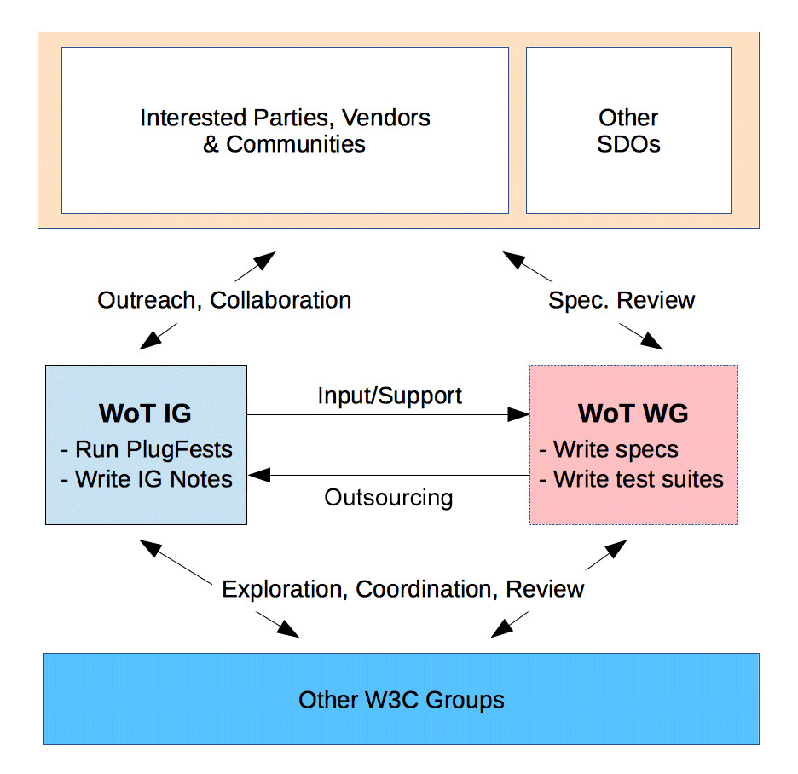
W3C WoT
Interest Group (IG)
Working Group (WG)
https://www.w3.org/2016/07/wot-ig-charter.html
Started spring 2015
218 participants
Informal work, outreach
Use cases, explorative work
Liaisons and collaborations with other organizations and SDOs
PlugFests with running code
https://www.w3.org/2016/12/wot-wg-2016.html
Started December 2016
71 participants
Normative work
Standardization of four initial building blocks identified by the IG

Slide 19
W3C WoT Task Forces
IG
Current Practices (has deliverable)
Testing (PlugFest scenarios)
Thing Lifecycle
Synchronization of Servients
Linked Data and Semantic Processing
Demonstrators
Liaison with OCF
Liaison with oneM2M (tbc, You’re wanted ☺)
WG
Architecture (has deliverable)
Thing Description (has deliverable)
Type System (JSON Schema Extensions)
Hypermedia (Actions, error handling, …)
Scripting API (has deliverable)
Binding Templates (has deliverable)
Security & Privacy

Slide 20






W3C WoT Liaisons
IETF / IRTF
Established, joint meetings since Nov 2015
Open Connectivity Foundation (OCF)
Established, active alignment and joint PlugFest coming up
oneM2M
Established, commonality identified and preparing input
OPC Foundation
Established, need to agree on strategy etc.
Plattform Industrie 4.0
Initial conference calls
OpenFog
Initial outreach

Slide 21
WG Roadmap
Feb (Santa Clara F2F)
Create GitHub repos
May (Osaka F2F)
Graphical and RDF model of TD
Editor’s Drafts
RC for WoT Arch. FPWD
Jul (Düsseldof F2F)
Draft for test suite
Release FPWD of WoT Arch.
Nov (TPAC, Burlingame)
RCs for FPWD
RC Implementations and Test Suite
2017
Mar (London? F2F)
Finish security review
Release FPWDs
Jul (China? F2F)
Nov (TPAC, Asia?)
Finish security review
Start release process
2018
May (Santa Clara?)
Aggressive testing / adverse security testing?
Oct
RCs for Candidate Recommendations
Dec (end of current charter)
Release Candidate Recommendations (CRs)

Slide 22
W3C WoT Online Resources
W3C WoT Interest Group
https://www.w3.org/WoT/IG/ (blog)
https://www.w3.org/2016/07/wot-ig-charter.html (charter)
https://lists.w3.org/Archives/Public/public-wot-ig/ (subscribe to mailing list)
W3C WoT Working Group
https://www.w3.org/WoT/WG/ (dashboard)
https://www.w3.org/2016/12/wot-wg-2016.html (charter)
W3C WoT Wiki (IG+WG organizational information)
https://www.w3.org/WoT/IG/wiki/Main_Page
W3C WoT GitHub (IG technical proposals)
https://github.com/w3c/wot
W3C WoT WG Documents
https://w3c.github.io/wot-architecture/
https://w3c.github.io/wot-thing-description/
https://w3c.github.io/wot-scripting-api/
https://w3c.github.io/wot-binding-templates/

Slide 23
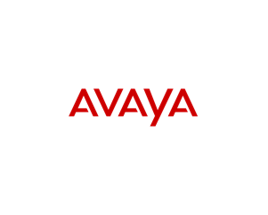





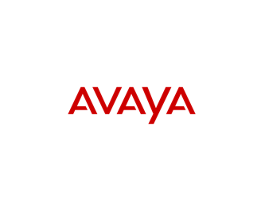











Web of Things Participants

Slide 24
oneM2M-WoT Interworking
Preliminary thoughts for discussion

Slide 25


Interworking: WoT→oneM2M
Exposing the WoT interface (described in TD) to oneM2M systems
Benefit: WoT services/data can be consumed by oneM2M applications
Actuator
provides
Thing Description
provides
Sensor
oneM2M Application (AE)
uses
WoT i/f
uses
WoT i/f
uses
Inter-working Proxy (AE)
Inter-working Proxy (AE)
encapsulate & map
WoT TD
mapping
Mca
Mca
Mca
oneM2M Resource Model
CSE
CSE
MN
Mcc
Infrastructure Node

Slide 26
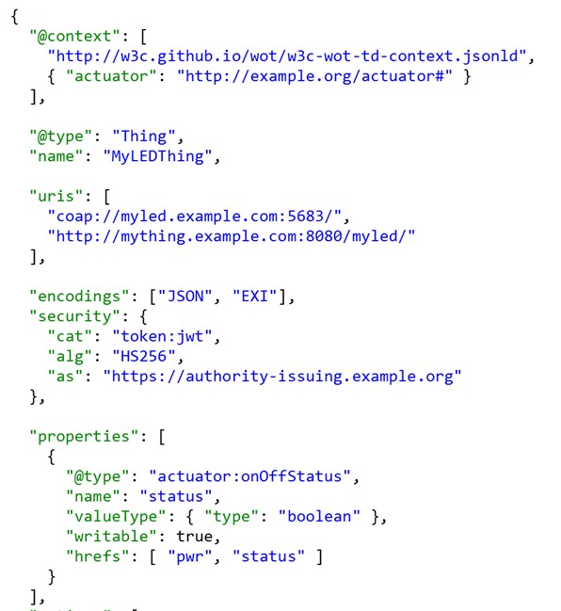
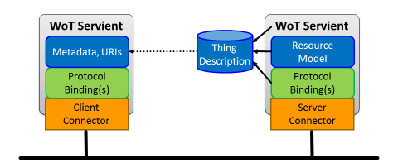
Interworking: oneM2M→WoT
Exposing oneM2M interfaces to WoT systems
Benefit: oneM2M services/data can be consumed by WoT Servients

Slide 27
oneM2M HAIM vs. WoT
well mapping based on large commonalities

Slide 28
oneM2M general Resource Model vs. WoT
distributed vs centralized

Slide 29
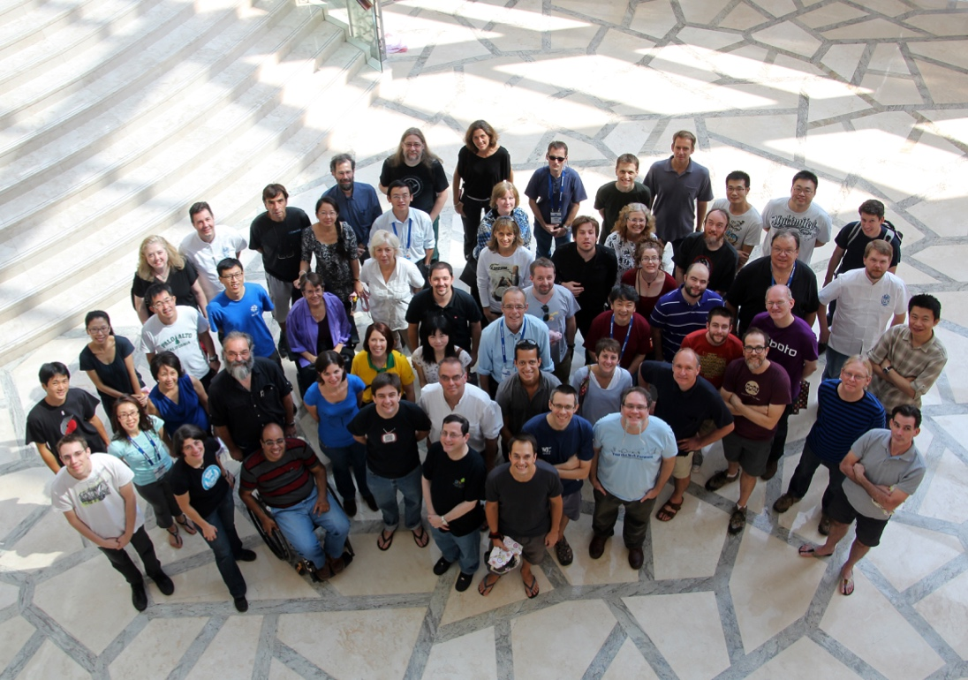
Thanks You!
For more information on W3C see:
www.w3.org
Notes:
Image: show human to human

